Slide 1
H2S-NN: Heterogeneous Heterophilic Sheaf Neural Network with Path Instances
No edit
Progress report · target venue IJCAI-27
Presented by Peeradon Sarnkaew
2026/11/11
Notes:
Good afternoon. I will present H2S-NN, our model for graphs that have many node and edge types and in which connected nodes often have different labels. I will present it as I would at IJCAI: the problem, the idea, the method, how we will test it, and what is still open. The model is final and implemented; the large experiments have not run yet, so you will see no accuracy numbers today.

Slide 2
Reviewer feedback on the submitted version (WSDM 2027)
Background
Problem
Method
Experiments
Discussion
R1 Weak Accept
R2 Weak Reject
R3 Weak Accept
R4 Weak Reject
Meta Reject
Liked
Main concerns
Path instance kept as a cell: novel (all)
Principled construction, with proof
Three tasks, many datasets
# | Concern | By
1 | Heterophily not shown: only IMDB strongly heterophilic | MR, R2–R4
2 | Face reaches nodes only via the closing (endpoint) edge | MR, R2, R4
3 | No scalability study (ACM 9.3 GB) | MR, R1, R3, R4
4 | Baseline tuning unclear; HetSheaf quoted | MR, R1, R2, R4
5 | No failing example; extra modules unmotivated | R2–R4
The idea was liked; the evidence for it was not convincing.
Notes:
How the submitted version was received at WSDM 2027: two weak accepts, two weak rejects, and a reject from the meta-reviewer. Everyone liked the core idea of keeping a concrete path instance as a cell instead of collapsing it into an edge between its ends, and most found the construction principled. The five main concerns: heterophily was not really shown, since only IMDB was strongly heterophilic; the face reached the nodes only through a closing edge between its two ends, which is exactly the endpoint view we criticised; no scalability study; the baseline protocol was unclear and HetSheaf was quoted; and the motivation lacked a concrete failing example. In short, the idea was liked but the evidence was not convincing.

Slide 3
Update since last meeting
Background
Problem
Method
Experiments
Discussion
Introduction & contribution
Methodology
Path sampling
Experiments
before
before
before
before
3 contributions
H2S-NN + AMPSS + SheafCovPool
closing edge, K steps
face reached nodes via closing edge
AMPSS
schema search + 4 budgets
3 + 4 + 4 datasets
HetSheaf quoted; tuning unclear
now
now
now
now
1 core idea + WISP
paths as faces, original graph
one energy, one solve
matrix-free maps
WISP
random walks; a weight per instance
8 + 8 + 4 datasets
all rerun, one protocol
Status: implemented and tested; ACM memory 9.3 → 2.8 GB. No accuracy runs yet.
Notes:
What changed since the last meeting, in four columns. Contributions: the paper no longer claims AMPSS and SheafCovPool; there is one core idea, path instances as faces with heterophily handled on the original graph, plus WISP as the sampler. Methodology: the closing edge, the K Hodge diffusion steps and the d-by-d maps are gone; faces sit above their paths, propagation is one energy and one solve, and every map is matrix-free, two reflections per edge end, so restriction maps are still there but never built as dense matrices. Path sampling: AMPSS with its schema search and four budgets became WISP. Experiments: from three, four and four datasets with quoted HetSheaf numbers to eight, eight and four datasets with every baseline rerun under one protocol. Status: the model is implemented and passes the theory, gradient and mutation tests, ACM memory went from 9.3 to 2.8 GB, and no accuracy runs have been made yet.

Slide 4
Outline
Background
Problem
Method
Experiments
Discussion
1.
Background
2.
Problem
No edit
3.
Method
4.
Experiments
5.
Discussion
Notes:
The talk has five parts. Background gives the four ideas you need: typed graphs, heterophily, meta-paths and sheaves. Problem shows what existing methods do with one concrete path and what they lose. Method presents our answer. Experiments states how each claim will be tested. Discussion separates what is new from what is not.

Slide 5
A heterogeneous graph: nodes/edges have types
Background
Problem
Method
Experiments
Discussion
P4
writes
A7
writes
writes
Node types 𝒯 = {paper, author, subject}
Relation types ℛ = {writes, has-subject, cites}
Paper (Target) Class: Math, Biology
Example: Citation networks, Recommendation Systems
No edit
P1
P9
has subject
S3
has subject
paper (colour = field)
author
subject
Types carry meaning: an author neighbour says something different from a subject neighbour.
Notes:
This is the running example for the whole talk. Papers, an author and a subject: nodes have types, and edges have types too, such as "writes" or "has subject". Formally, a heterogeneous graph has a type function for nodes and one for edges. Our task is to predict the field of each paper, shown by colour. Standard benchmarks of this kind are ACM, DBLP, IMDB and Freebase from the HGB benchmark. The point of this slide: a neighbour's type matters, so a model should not treat every neighbour the same way.

Slide 6
Meta-paths: a type pattern versus one concrete path
Background
Problem
Method
Experiments
Discussion
No edit
P4
Schema (type pattern): PAP
writes
writes
A7
P
A
P
PAP ≈ “two papers share an author”
P1
P9
APA ≈ “Co authors”
Instance (PAP)
P1 – A7 – P9: P1 and P9 share A7
P1 – A7 – P4: P1 and P4 share A7
A7 is the intermediate node
S3
Meta-paths [4] are the standard tool for typed multi-hop relations. It can encode semantic meanings
Notes:
A meta-path schema is a type pattern: paper, author, paper means two papers share an author. An instance is one concrete path that follows it, such as P1, A7, P9. The middle node, A7, is the intermediate node. Our research question is about this node: does it matter who A7 is, and should A7 itself learn that P1 and P9 are linked? Keep this question in mind; every later slide answers part of it.

Slide 7
Heterophily: connected nodes have different labels
Background
Problem
Method
Experiments
Discussion
No edit
Homogeneous
Homophily
Homogeneous Heterophily
Heterogeneous Heterophily
P4
A7
P1
P9
S3
Average the neighbours → label is kept
Average the neighbours → labels are blurred
P1 and P9 share author A7, but work in different fields
Being connected does not mean being similar; plain averaging (GCN) can hurt.
Notes:
A GCN updates a node with the average of its neighbours. That works when neighbours share the label, which we call homophily, left. It fails under heterophily, right: neighbours have different labels and averaging mixes them. The simplest measure is edge homophily: the fraction of edges whose two ends have the same label. Near one is homophilic, near zero heterophilic. In our example P1 and P9 share author A7 but are in different fields. So being connected does not mean being similar, and that is the first difficulty.

Slide 8


Measuring heterophily: H²[6] on heterogeneous graph
Background
Problem
Method
Experiments
Discussion
P4
A7
P1
P9
𝒫₂
Homogeneous Subgraph from l =2 meta-paths
S3
No edit
G_{p}
paper graph that meta-path p induces
PAP
h_{adj}
homophily corrected for class imbalance
P1
P9
h₁(G) = 0/1
y: node label
near 1: homophily
near 0: heterophily
+
PSP, PPP
P1
P4
h₂(G) = 1/1
1- h(G) = 1 + (0+1) = 0
Notes:
On a typed graph, labels are compared between papers, so heterophily is measured on the paper graphs that meta-paths induce. The H2GB benchmark defines the index H-squared: for each length-two meta-path, build the induced paper graph, measure its adjusted homophily, which corrects for class imbalance, and average one minus that value. Zero means homophilic; around one, heterophilic. The chart shows our values: DBLP is homophilic, IMDB clearly heterophilic, IEEE-CIS-G and Freebase almost fully heterophilic. Freebase is dominated by unlabeled books, which the reference code fills at random; we also report a labeled-only value. With this range we can test whether gains grow with heterophily.

Slide 9
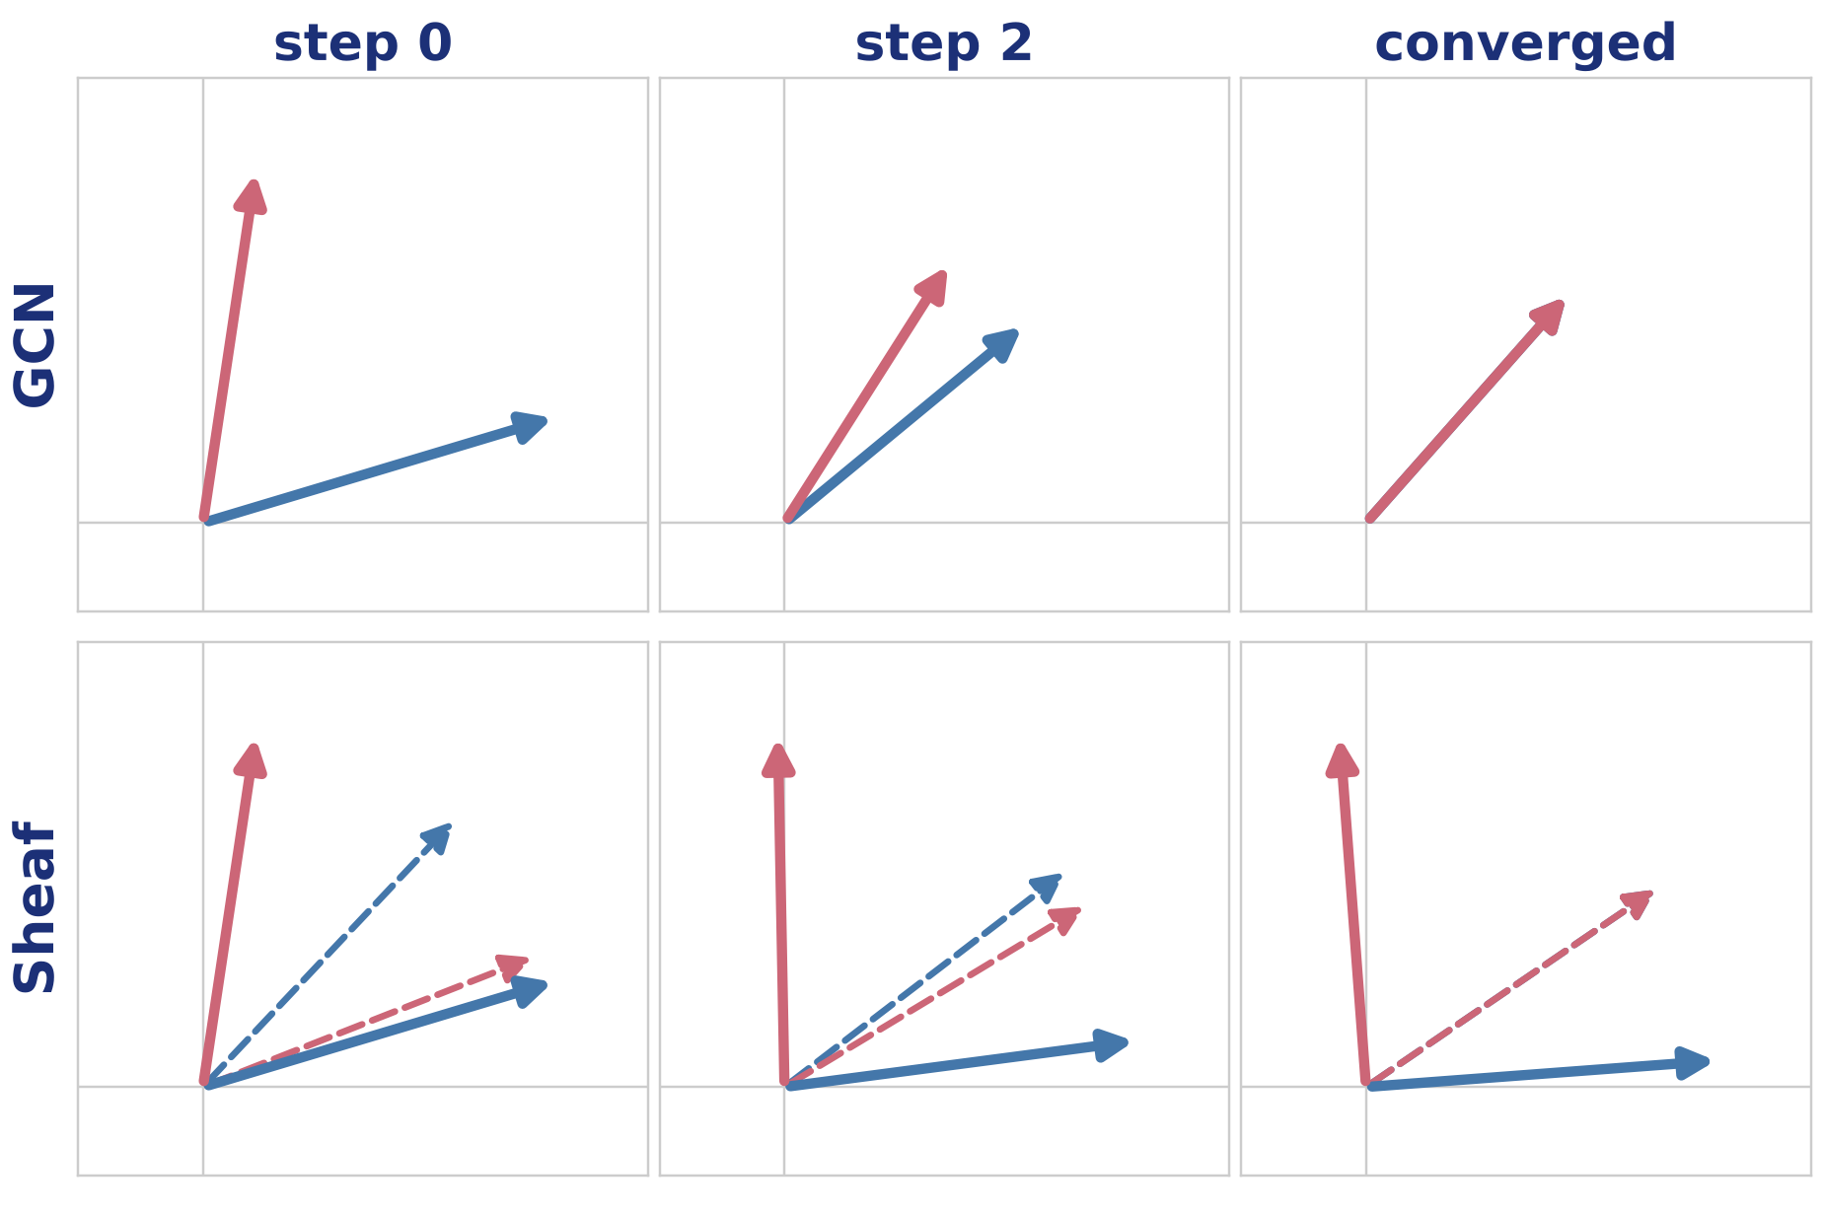
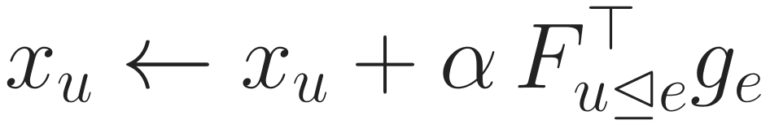
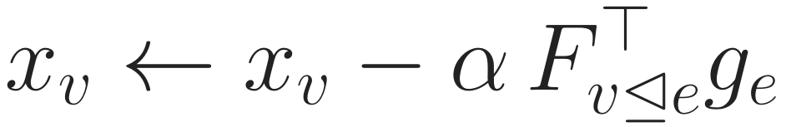
Sheaf diffusion: agree inside the edge, stay different
Background
Problem
Method
Experiments
Discussion
One step moves both nodes
Both move to close the gap inside e
GCN: F = I, so the gap is xᵥ − xᵤ: they merge
Example: Fᵤ rotates +30°, Fᵥ rotates −60°.
Converged: xᵤ ≈ east, xᵥ ≈ north (cleaned, still different); inside e both point the same way.
xᵤ
xᵥ
Fᵤ◁ₑxᵤ
Fᵥ◁ₑxᵥ (inside e)
Diffusion removes only the disagreement the maps cannot explain, so each node keeps its class.
GCN [2] · sheaf networks [7, 8] · HetSheaf [9]
Notes:
Two neighbours of different classes: u, blue, roughly east; v, pink, roughly north. Each end of the edge has its own map into the edge's space: here u's map rotates by plus thirty degrees and v's by minus sixty. The dashed arrows are the two nodes as the edge sees them. One diffusion step computes the gap inside the edge and moves both nodes, u by F_u-transpose times the gap and v the opposite way, so both original vectors move. Top row: GCN has identity maps, so the gap is just the difference of the two vectors and they merge into one, losing the class. Bottom row: with maps, the dashed arrows meet inside the edge, while u ends almost exactly east and v almost exactly north: the small noise is removed and the classes are kept. That is the whole idea of a sheaf: agreement is required only after the maps.

Slide 10
How heterophily is handled today: decompose, then fuse
Background
Problem
Method
Experiments
Discussion
1 Original graph
2 One graph per schema
3 Encode each view
4 Fuse
P4
PAP view
P9
GNN on this view
heterophily handled here
A7
P1
P4
attention over views → ŷ
P1
P9
S3
PSP view
GNN on this view
heterophily handled here
P1
P9
A7 and S3 are gone
Heterophily is studied indirectly: on derived graphs, one per meta-path schema, then fused.
Decompose-then-fuse [18, 20, 21] · schema-level encoders [10, 11] · per-schema instance encoders [12, 22]
Notes:
How do current methods handle a graph that is both heterogeneous and heterophilic? Most of them first decompose it. Step one is the original graph. Step two builds one paper-only graph per meta-path schema: in the PAP view P1 is linked to P9 and P4 because they share an author; in the PSP view P1 is linked to P9 because they share a subject. Notice that A7 and S3 are no longer in either graph. Step three runs a network on each view, and this is where heterophily is handled, for example by separating homophilic and heterophilic neighbours of the derived graph. Step four fuses the views, usually with attention. Hetero2Net, HDHGR and LatGRL follow this pattern for heterophily; HAN and SeHGNN do the same for heterogeneous graphs in general; even MAGNN, which keeps instances, processes each schema separately.

Slide 11

Two limitations of decompose-then-fuse
Background
Problem
Method
Experiments
Discussion
Limitation 1 judged on derived graphs
Limitation 2 pairs differ only by their endpoints
One homophily per view
Original typed edges never used
Depends on a hand-made schema list
P1
A7
P9
P1
P9
P1
A2
P9
one edge, weight 2
Only a count survives
A7 never learns P1–P9 are linked
Goal: heterophily on the original graph, one model.
Goal: path instances act as structure.
Both limitations come from the same step: the graph is replaced by schema views before learning starts.
Notes:
Decompose-then-fuse has two limitations. Left: heterophily is judged and handled on the derived graphs, one homophily value per view, not on the original typed graph; the original edges such as P1 to A7 never enter the computation, and which neighbours count depends on a hand-picked schema list. Right: within one schema, two paper pairs are distinguished only by their endpoints. The PAP view is the matrix product of paper-author and author-paper adjacency, so its entry for P1 and P9 is just the number of shared authors. Whether the path goes through A7 or A2 makes no difference, and A7 itself never learns that P1 and P9 are linked. Both limitations come from replacing the graph by schema views before learning starts. Our two goals answer them one to one.

Slide 12
Our view and the research questions
Background
Problem
Method
Experiments
Discussion
Our view
P4
Running question
Does it matter who A7 is? Should A7 learn that P1 and P9 are linked?
Heterophily on the original graph
no per-schema views
A7
1
P1
P9
2
Meta-paths are structure, not input
each path instance is a face
S3
RQ1
Can a single model on the original graph handle heterophily using path instances, without per-schema branches?
3
Face attached to its nodes and edges
no closing edge
4
A learned weight per instance
from its nodes and relations
RQ2
Do path instances, used as structure, carry information that schema-level encoders and instance-level features do not?
RQ1 answers limitation 1; RQ2 answers limitation 2.
Notes:
Our view, in four points. Heterophily is handled on the original graph. Meta-paths are part of the structure the model operates on, not extra input. Each sampled path instance becomes a face attached to the nodes and edges it traverses, with no closing edge, so the path does not need to return to its start. And each instance has its own learned weight. This gives two research questions. RQ1: can a single model on the original graph handle heterophily using path instances, without per-schema branches? RQ2: do path instances, used as structure, carry information that schema-level encoders and instance-level features do not? In terms of our example: does it matter who A7 is, and should A7 itself learn that P1 and P9 are linked?

Slide 13
Related work: where each family puts the path
Background
Problem
Method
Experiments
Discussion
Family | Works on the original graph | Uses the path instance | Updates the intermediate node | Where heterophily is handled
Decompose-then-fuse Hetero²Net, HDHGR, LatGRL [18, 20, 21] | ✗ | ✗ | ✗ | per derived view
Schema-level encoders HAN, SeHGNN [10, 11] | ✗ | ✗ | ✗ | not targeted
Instance encoders MAGNN, MECCH [12, 22] | ✗ | ✓ as a feature | ✗ target only | not targeted
Sheaf networks NSD, HetSheaf [8, 9] | ✓ | ✗ edges only | n/a | learned edge maps
Cell / hypergraph networks CWN, sheaf hypergraphs [13, 14] | ✓ | partly free maps | ✓ | not targeted
H2S-NN (ours) | ✓ | ✓ as a face | ✓ | edge maps + path compositions
No family both stays on the original graph and lets one path update all of its nodes.
Notes:
Here are the families, compared on the properties our questions need. Decompose-then-fuse methods for heterophily, such as Hetero2Net, HDHGR and LatGRL, and schema-level encoders such as HAN and SeHGNN, work on derived graphs and never see an instance. Instance encoders such as MAGNN and MECCH do use the instance and its intermediate node, but as a feature written into the target node only; A7 is not updated. Sheaf networks such as NSD and HetSheaf stay on the original graph and handle heterophily with learned edge maps, but they only see edges. Cell-complex and sheaf-hypergraph networks update every node of a cell, but their cell maps are free and they do not target typed graphs or heterophily. Our model is the row at the bottom: on the original graph, the instance as a face, every node updated, and heterophily handled by edge maps and their compositions along the path.

Slide 14
Contributions
Background
Problem
Method
Experiments
Discussion
1
Path instances as faces of the graph’s own sheaf
maps composed from edge maps; every node of the path hears it; no closing edge
RQ2
2
One objective on the original graph
heterophily via edge maps, meta-paths via faces; no per-schema branch
RQ1
3
WISP: schema-free sampling
random walks with unbiased weights; a learned weight per instance
RQ1, RQ2
4
Controlled evaluation
8 datasets across heterophily; all baselines rerun; ablations as configurations
concerns 1–4
Every comparison our questions need is a configuration of the same model.
Notes:
Our contributions, each tied to a research question. One: path instances become faces of the same sheaf that lives on the graph, with maps composed from the edge maps, so every node of the path, including the intermediate one, hears the path, with no closing edge; this serves RQ2. Two: one objective on the original graph handles heterophily through edge maps and meta-path information through faces, without per-schema branches; that is RQ1. Three: WISP samples path instances without a schema list and learns a weight for each. Four: an evaluation designed to answer the reviewers: eight datasets across the heterophily range, every baseline rerun, and every ablation a configuration of the same model.

Slide 15

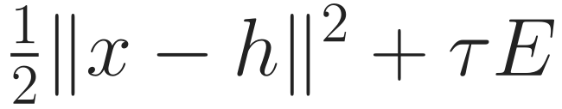
H2S-NN in one picture: what flows, and why each step
Background
Problem
Method
Experiments
Discussion
Map
Goal
Step 0
Fix 1
Fix 2
WISP
Solve
Learn
RQ
1 Encode
2 Edge maps
3 Faces
4 Objective
5 Solve
6 Predict
MLP
10 CG steps
node
link
graph
h ∈ ℝ^{N×d}
F per edge end
faces f, weight β_f
𝒥 = anchor + τE
x*, z* = arg min 𝒥
ŷ = MLP([x*, h])
one space for all types
different classes can agree
keep each path, A7 included
one rule for both goals
the propagated vectors
own + propagated
task loss ℒ(ŷ, y): gradient flows back through one extra solve
Learned: encoders, maps, weights, τ, head. Not learned: face maps (composed), the sampler. Next: why each piece.
Notes:
The whole model in six steps, with what flows between them. Encode: every node type goes into one d-dimensional space, giving h. Edge maps: each end of each edge gets a map F, so that different classes can agree after the map. Faces: sampled path instances, each with a weight beta, so that each path, including its intermediate node, is kept. Objective: one rule, stay close to h plus tau times the energy E. Solve: the propagated vectors are the minimiser. Predict: a small network reads both the own encoding and the propagated vector. The task loss sits at the end and its gradient flows back through one extra linear solve. The next slides build this up from the simplest propagation rule, showing why each piece is there.

Slide 16
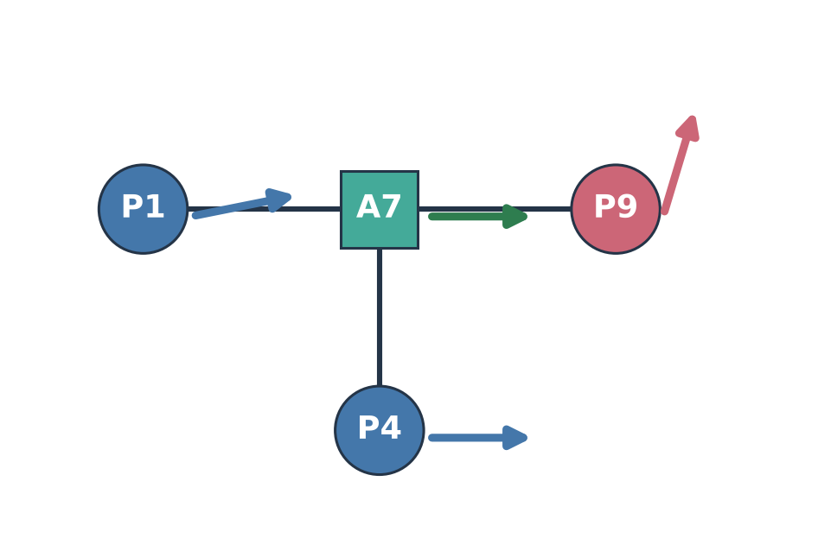
What must propagation do? Two requirements
Background
Problem
Method
Experiments
Discussion
Map
Goal
Step 0
Fix 1
Fix 2
WISP
Solve
Learn
RQ
H stay different
P1 (ML) and P9 (Biology) are linked through A7. After propagation they must still point different ways; only their noise should go.
M the path acts as a unit
P1–A7–P9 must reach P1, A7 and P9; its effect must depend on who A7 is, not only on the pattern PAP.
Input encodings h (toy, d = 2): ML papers point east, Biology north, A7 learned (east). P1 and P9 carry noise.
Plan: start from the simplest rule, see where it fails on this example, fix one term at a time.
H is RQ1 (heterophily on the original graph); M is RQ2 (paths as structure).
Notes:
Before any equation, what must propagation do? We use one toy example throughout: four nodes, two-dimensional encodings. ML papers P1 and P4 point east, the biology paper P9 points north, A7 has a learned encoding pointing east, and P1 and P9 carry some noise. Requirement H, for heterophily: P1 and P9 are linked through A7, yet after propagation they must still point different ways; only the noise should go. Requirement M, for meta-paths: the path P1-A7-P9 must reach all three of its nodes, and its effect must depend on who A7 is, not just on the pattern PAP. H is research question 1, M is research question 2. The plan: start from the simplest propagation rule, watch it fail on this example, and fix one term at a time.

Slide 17
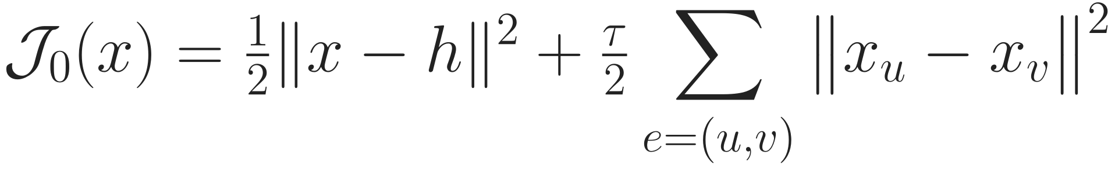
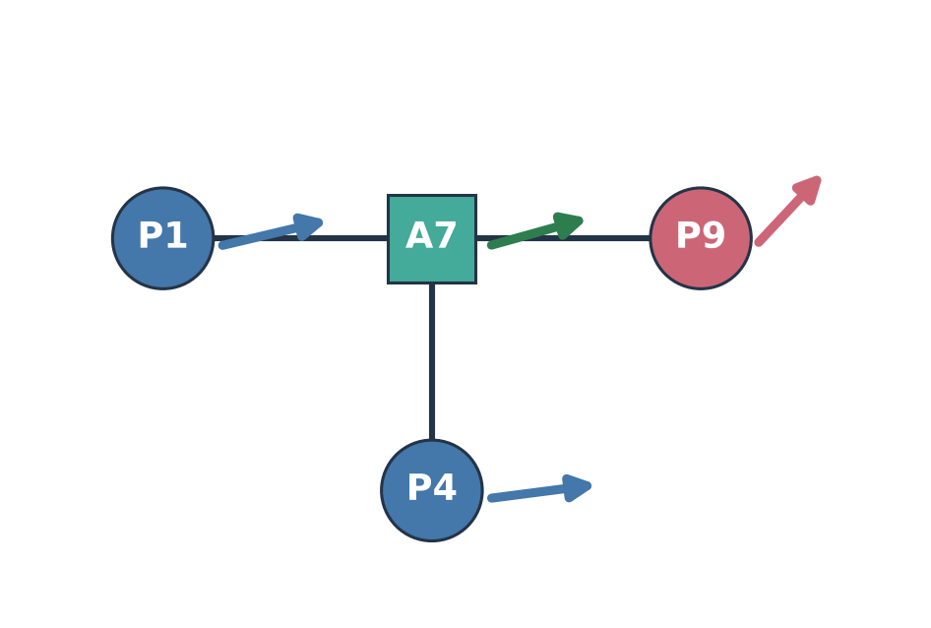
Step 0: the simplest rule (APPNP) and where it fails
Background
Problem
Method
Experiments
Discussion
Map
Goal
Step 0
Fix 1
Fix 2
WISP
Solve
Learn
RQ
stay near your encoding; be equal to your neighbours. Minimiser = APPNP [16]; one gradient step = a GCN layer [2]
H fails
P9: (0.3, 1.0) → (0.58, 0.62). cos(P1, P9): 0.47 → 0.83. P9 is pulled halfway to ML because A7 links them.
M fails
The path is only two edges. A7 is just a neighbour; P1–A7–P9 and P1–A2–P9 have the same effect.
x* for τ = 1, edge weights 1
Keep: unique minimiser, anchor to h (no oversmoothing)
The failure is in the second term: “be equal” is the wrong notion of agreement.
Notes:
Step zero is the simplest rule we can write: stay close to your encoding, and be equal to your neighbours. Its minimiser is APPNP, personalised PageRank, and one gradient step on it is a GCN layer. On our example, with tau one, requirement H fails: P9 moves from pointing north to pointing halfway between north and east, because A7 links it to two ML papers; the cosine between P1 and P9 jumps from 0.47 to 0.83. Requirement M also fails: the path is only two edges, A7 is just another neighbour, and swapping A7 for any other author changes nothing. What we keep from this rule is its form: a unique minimiser and the anchor to h, which prevents oversmoothing. What we change is the second term: being equal is the wrong notion of agreement.

Slide 18
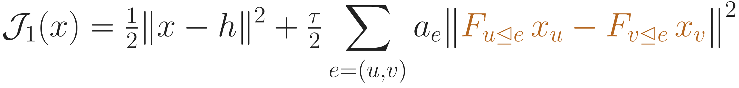

Fix 1: agree after a learned map (requirement H)
Background
Problem
Method
Experiments
Discussion
Map
Goal
Step 0
Fix 1
Fix 2
WISP
Solve
Learn
RQ
each end of an edge is first mapped into the edge’s space; agreement is required only there
H holds
P9: (0.3, 1.0) → (0.16, 1.0); cos(P1, P9): 0.47 → 0.25. Noise removed, direction kept.
Why it works: inside e₂ both P9 and A7 point east, so there is nothing to smooth; only the part the maps cannot explain is removed.
F is a rotation/reflection (never shrinks), computed from both ends of the edge, and learned from the labels.
Guarantee: for any labelling such maps exist, so a class-separated state has zero energy.
here Fₚ₉◁ₑ₂ rotates north → east; all other F = I
Heterophily is handled on the original edges: the maps decide what “agree” means. M still fails.
Notes:
Fix one. Instead of comparing x_u and x_v directly, each end of the edge is first mapped into the edge's own space, and agreement is required only there. On the example we let the map of P9 on edge e2 rotate north to east and leave the others as identity. Now requirement H holds: P9 keeps pointing north, its noise is removed, and the cosine between P1 and P9 drops to 0.25. Why: inside e2, P9 and A7 both point east, so there is nothing left to smooth; only the part of the disagreement that the maps cannot explain is removed. In the real model F is a rotation or reflection, so it never shrinks a vector; it is computed from both ends of the edge, and it is learned from the labels through the task loss. We proved that for any labelling such maps exist, so a class-separated state has zero energy and is kept. This is how heterophily is handled on the original graph. Requirement M still fails: the path is still two edges.

Slide 19
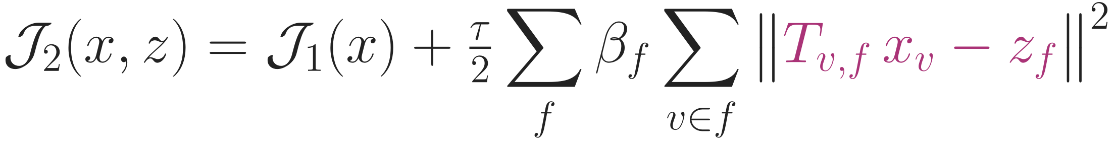
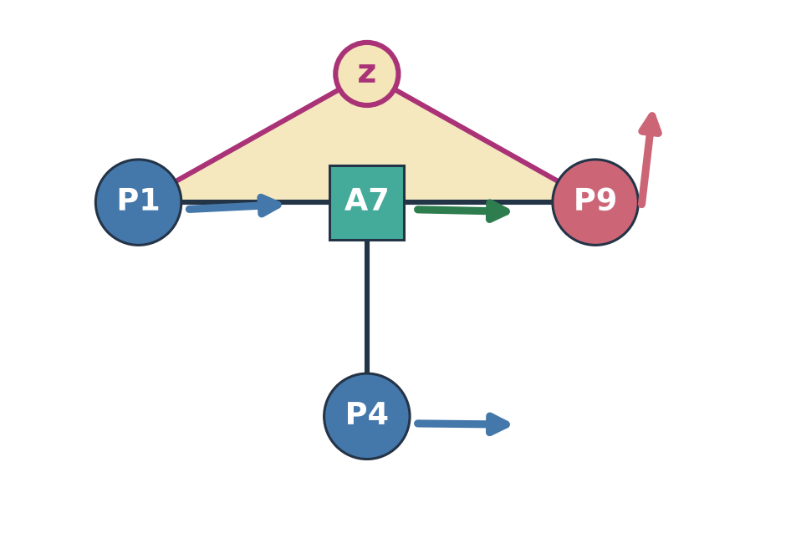
Fix 2: a state for each path instance (requirement M)
Background
Problem
Method
Experiments
Discussion
Map
Goal
Step 0
Fix 1
Fix 2
WISP
Solve
Learn
RQ
each sampled path f gets its own state z_f; every node on f must agree with it, after its path map T
M holds
 | two edges (step 1) | face
reaches A7 | as a neighbour | yes, A7 meets z_f
who A7 is | no | yes: T, β_f read A7
order of relations | no | yes: T in path order
P1–P9 shortcut | – | none
Example: P9 → (0.12, 1.0), cos 0.17: one more consistent witness, no new parameters.
The path is now structure: own state, own maps, heard by every node on it. H and M both hold.
Notes:
Fix two. Each sampled path instance f gets its own state z_f, and every node on the path must agree with it after its path map T. T is not learned: it is the composition of the edge maps along the path, so A7 is carried through e1 into P1's frame and P9 through e2 and e1. Now requirement M holds. Compare with the two-edge view: A7 now meets the path state directly instead of being just a neighbour; who A7 is matters, because T and the weight beta read A7; the order of relations matters, because T is composed in path order, so P-A-P and P-S-P give different maps; and there is no shortcut between P1 and P9. On the example the face adds one more consistent witness: P9's noise drops further, to 0.12, with no new parameters. Both requirements now hold.

Slide 20
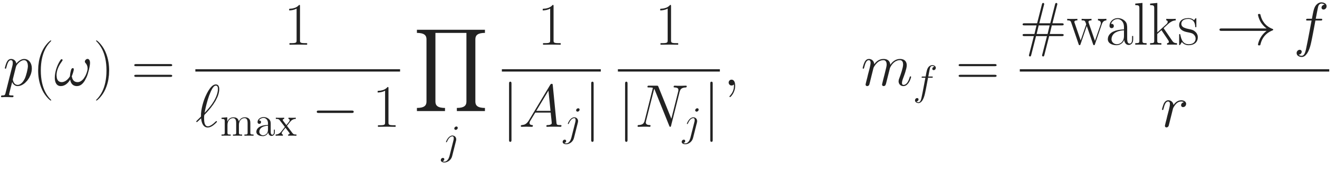
WISP: which faces, and how strong each one is
Background
Problem
Method
Experiments
Discussion
Map
Goal
Step 0
Fix 1
Fix 2
WISP
Solve
Learn
RQ
1 Sample: random walks from every target node
2 Weight: each instance by who is on it
P9
p = 1/12
P1
A7
P9
weight high
A7
P4
p = 1/12
P1
A2
P9
weight low
P1
S3
P9
p = 1/6
g: a small MLP shared by all schemas
Schemas are read out afterwards, never selected
v1 needed a schema search and 4 budgets
uniform length, action and unvisited neighbour; no schema list; new walks every epoch
β_f is the face weight in the objective: unbiased sampling × learned relevance.
Notes:
Which paths become faces, and how strongly does each count? First, sampling. From every target node we draw random walks: a uniform length, then at each hop a uniform choice of relation and a uniform unvisited neighbour. On our example the walk P1-A7-P9 has probability one twelfth, P1-S3-P9 one sixth. One walk is one face; m_f counts how often the face was drawn, divided by the number of walks per node, which makes the result unbiased. No schema list is used, and walks are redrawn every epoch. Second, weighting. A small network g reads every node encoding and relation on the path, so two instances of the same schema, through A7 or through A2, can get very different weights. The product is beta_f, the face weight in the objective. Schemas are read out after training, never selected; v1 needed a schema search and four budgets.

Slide 21
WISP vs. other ways of choosing meta-paths
Background
Problem
Method
Experiments
Discussion
Map
Goal
Step 0
Fix 1
Fix 2
WISP
Solve
Learn
RQ
Method | Candidate paths | Chosen at | Chosen by | A7 updated
HAN, SeHGNN [10, 11] | expert list / all ≤ k hops | schema | human / attention | ✗
GTN [25] | soft mix of edge types | schema | end-to-end | ✗
PMMM [29], LMSPS [26] | searched, keep top-k | schema | search on val. loss | ✗
AMP-HGNAS, MCTS [30, 31] | NAS / tree search | schema | search score | ✗
AHGNN [27] | all ≤ length | schema, per node | end-to-end | △ hop means
MECCH [22] | all of length K | schema | end-to-end | ✗ target only
MF2Vec [28] | schema-free walks | instance | end-to-end | ✗ edge weight
v1 AMPSS | DFS + budgets | both | held-out split | △ closing edge
WISP (ours) | walks, stated p, unbiased | instance | end-to-end | ✓ every node
Not new: schema-free walks (MF2Vec). New: choice per instance, and the instance acts on every node.
Sampling only proposes candidates; which instance matters is learned. Not yet shown to beat search.
Notes:
Is WISP just random sampling, and is it better than meta-path search? Compared with other papers. HAN uses an expert list and SeHGNN all meta-paths up to k hops; both decide at the schema level. GTN learns a soft mix of edge types end to end, still at the schema level. PMMM and LMSPS search for meta-paths and keep the top k, LMSPS by validation loss; AMP-HGNAS and MCTS-HGNN use architecture search or tree search. AHGNN enumerates all meta-paths up to a length and attends per node, using hop-wise averages. MECCH uses all meta-paths of length K with intermediate nodes averaged into the target only. MF2Vec is closest to us: schema-free walks and intermediate facets, but the path ends up as an edge weight. Our v1 searched schemas with a held-out split. WISP's random walks only propose candidates from a stated distribution; the decision is made per instance by the learned weight, and the instance acts on every node of the path. So: schema-free walks are not new; choosing per instance and updating every node is. Honestly, we have not yet shown that this beats search methods.

Slide 22
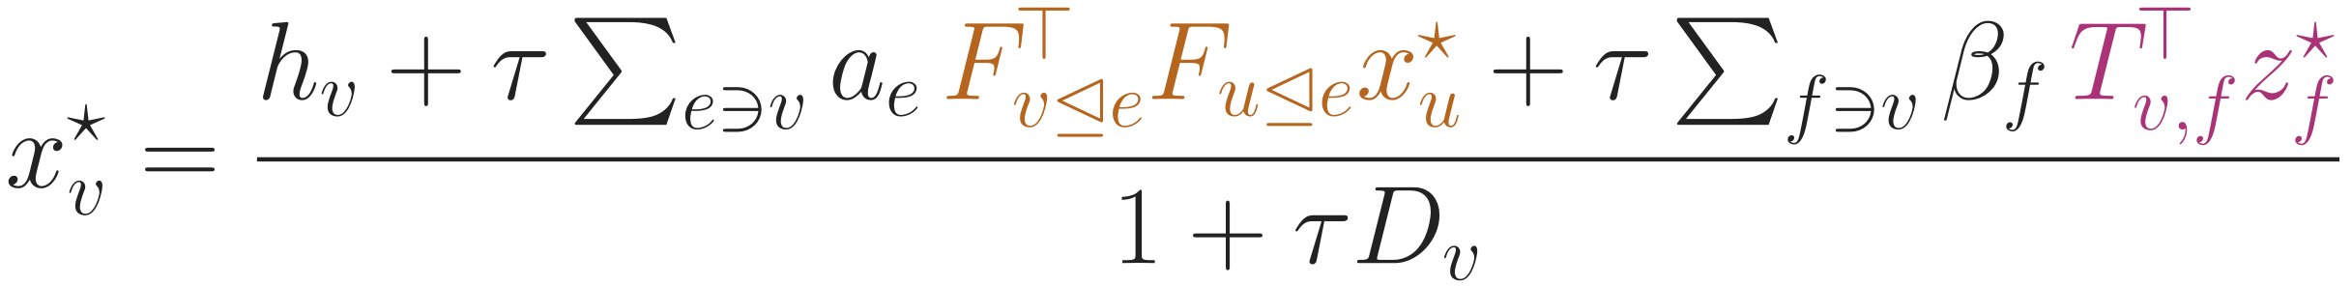

Putting it together: one objective, one solve
Background
Problem
Method
Experiments
Discussion
Map
Goal
Step 0
Fix 1
Fix 2
WISP
Solve
Learn
RQ
Minimiser: every node in balance (∂𝒥/∂x = 0)
How it is computed
Iterating the balance = message-passing layers; we solve it directly instead
(PᵀP + τL̂) Y = Pᵀh by conjugate gradient, ≈ 10 steps
Unique for any F, a, β, τ; no depth to tune; τ learned
own encoding + neighbours carried through the maps + paths carried back; Dᵥ = Σaₑ + Σβ_f
z*_f = mean of Tᵥ,f x*ᵥ over the path
own part kept separate [3]
This is the propagation rule we set out to build: maps answer H, faces answer M, one solve gives both.
Full form (edge states, normalisation) in the appendix; without faces: personalised PageRank on a sheaf [16]
Notes:
Putting it together. The objective has the anchor, the edge term with maps, and the face term. At the minimiser the gradient is zero, which gives a balance equation for every node: x-star is a weighted average of its own encoding, its neighbours carried through the edge maps into its frame, and the states of the paths it lies on carried back through T. Iterating this balance would be message passing; we instead solve the linear system directly by conjugate gradient, about ten steps, and the answer is unique for any parameters, with tau learned and no depth to tune. The head reads x-star together with h, so the node's own information is kept separate. This is exactly the rule we set out to build: the maps answer requirement H and the faces answer requirement M.

Slide 23
What is learned, and what the loss is
Background
Problem
Method
Experiments
Discussion
Map
Goal
Step 0
Fix 1
Fix 2
WISP
Solve
Learn
RQ
Component | Parameters | Enters 𝒥 as
Type encoders | W_t, b_t per node type | h
Edge maps | MLP → 2 reflection vectors per edge end; frame per (relation, role) | F
Edge weights | MLP → aₑ > 0 | aₑ
Instance weights (WISP) | MLP g per path length → β_f > 0 | β_f
Strength | τ = e^θ, one scalar | τ
Head | MLP on [x*, h] | – (after the solve)
gradient: one adjoint solve with the same matrix; memory ∝ states, not solver steps
Not learned: face maps T (composed from F), the walk sampler, the solver.
ℒ: cross-entropy (node, graph), binary (IMDB, links). 𝒥 is not the loss: it defines the forward pass.
The task loss shapes F, a, β and τ; that is how the model learns what “agree” means on each graph.
Notes:
What is learned and what the loss is. The learned parts are the type encoders, the edge-map network that outputs two reflection vectors per edge end plus a frame per relation and role, the edge-weight network, the instance-weight network g, one scalar tau, and the head. The face maps T are composed from F, and the sampler and solver have no parameters. The training problem is: minimise the task loss of the head applied to x-star and h, where x-star is the minimiser of the objective. So the objective J is not the loss; it defines the forward pass, and the loss is the usual cross-entropy or binary cross-entropy. The gradient reaches every parameter through one adjoint solve with the same matrix, so memory is proportional to the states and not to the number of solver steps. This is also the answer to 'where do the maps come from': the task loss shapes them, so the model learns what agreement means on each graph.

Slide 24
How the method answers the research questions
Background
Problem
Method
Experiments
Discussion
Map
Goal
Step 0
Fix 1
Fix 2
WISP
Solve
Learn
RQ
 | Mechanism in the model | Where it is tested
RQ1 heterophily, original graph, no per-schema branch | edge maps F (agree after a map); anchor to h; head reads [x*, h]; one objective on the original graph | gain vs. ℋ² across 8 datasets; maps → identity; vs. Hetero²Net, HetSheaf, R-GCN
RQ2 path instances as structure | face state z_f; maps T composed in path order; weight β_f from all nodes of the path; every node on the path updated | no faces; face → closing edge; face → feature; weight uniform / endpoints; known-answer task
Both | WISP: candidates without a schema list; selection per instance, end-to-end | expert list on the same model; LMSPS schemas (proposed); ℓmax curve
Each mechanism was added for one requirement; each has an ablation that can remove it.
Notes:
Finally, how the method maps onto the research questions. RQ1, heterophily on the original graph without per-schema branches, is carried by the edge maps, the anchor to h, the head reading both parts, and the fact that there is one objective on the original graph; it is tested by the gain against H-squared across the eight datasets, by replacing the maps with the identity, and by comparison with Hetero2Net, HetSheaf and a tuned R-GCN. RQ2, path instances as structure, is carried by the face state, the composed maps, the per-instance weight and the fact that every node on the path is updated; it is tested by removing faces, replacing them with closing edges or features, restricting the weight, and by a known-answer task. WISP serves both: candidates without a schema list, selection per instance. Every mechanism was added for one requirement, and every one has an ablation that can remove it.

Slide 25
Datasets: three tasks, homophilic to heterophilic
Background
Problem
Method
Experiments
Discussion
Data
Metrics
Protocol
Cost
Ablation
Analysis
Node classification | Source | Nodes | Target (classes)
ACM, DBLP, IMDB | HGB [1] | 11k–26k | paper 3, author 4, movie 5*
Freebase | HGB [1] | 180k | book (7)
IEEE-CIS-G | H2GB [5] | 154k | fraud (2)
mag-year, ogbn-mag | H2GB [5] | 1.9M | paper (5 / 349)
H-Pokec | H2GB [5] | 1.7M | user (2)
* multi-label
large graphs need mini-batch (design pending)
Link prediction (8) | Graph classification (appendix)
ACM P–A, DBLP A–P, IMDB M–A, Freebase B–B, PubMed, LastFM, ogbn-mag P–P, H-Pokec U–U | MUTAG, PROTEINS, ENZYMES, NCI1 [23]; types from labels
Eight node datasets span the heterophily range (concern 1).
Notes:
Three tasks. Node classification uses eight datasets: four from HGB, ACM, DBLP, IMDB and Freebase, and four large heterophilic graphs from H2GB: IEEE-CIS-G for fraud, mag-year and ogbn-mag, and H-Pokec. The large ones need mini-batch training, which still has to be designed. Link prediction has eight tasks, four derived from the node graphs so types and labels are real, plus PubMed and LastFM and two large ones. Graph classification uses the four TU datasets of HetSheaf; their types come from labels, so it only shows that the model covers the task, with no heterophily claim.

Slide 26
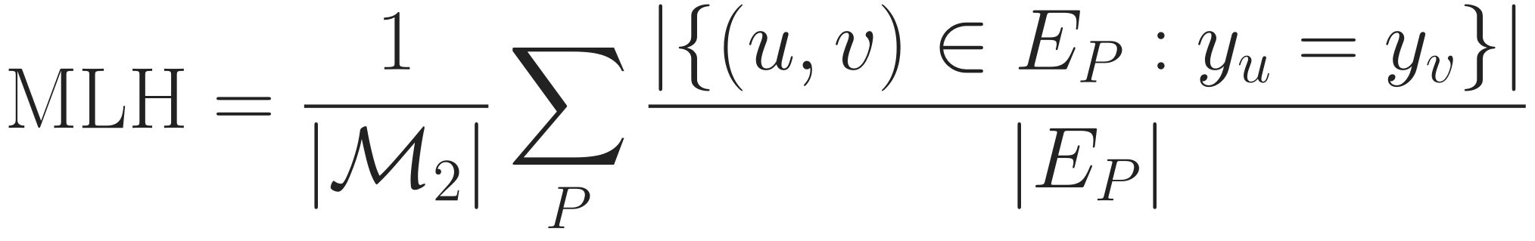
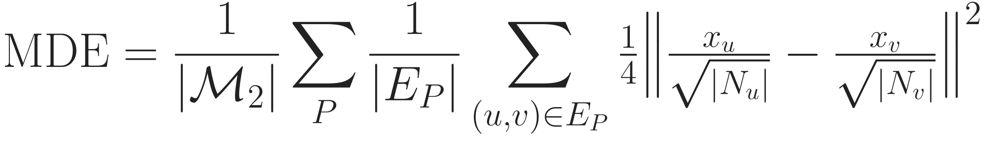
Heterophily metrics: labels (MLH) and features (MDE)
Background
Problem
Method
Experiments
Discussion
Data
Metrics
Protocol
Cost
Ablation
Analysis
MLH: do linked nodes share a label?
MDE: do linked nodes look alike?
E_P: edges of the graph meta-path P induces; y: label
Purpose: near 1 homophilic, near 0 heterophilic
x: raw features; N: neighbours in E_P
Purpose: large = feature heterophily; per dataset only
ℳ₂: length-2 meta-paths from Hetero²Net [18] (ACM PAP, PSP, PTP; DBLP APA; IMDB MDM, MAM, MKM), same set for MLH, ℋ², MDE. First reproduce Hetero²Net’s published values.
Labels and features can disagree; reporting both answers concern 1.
Notes:
Two heterophily metrics complement H-squared from the background. MLH, from Hetero2Net: for each length-two meta-path, build the graph it induces on target nodes and count the fraction of edges whose ends share a label; average over meta-paths. Near one is homophilic. On our toy PAP graph it is one half. MDE looks at features instead of labels: the average degree-normalised feature difference across meta-path edges; large means linked nodes look different. It depends on feature scale, so it describes a dataset rather than ranking datasets. All three metrics use the same meta-path list, and we first reproduce Hetero2Net's published values.

Slide 27
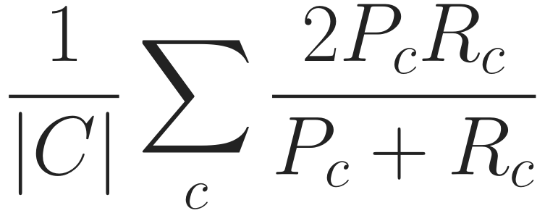
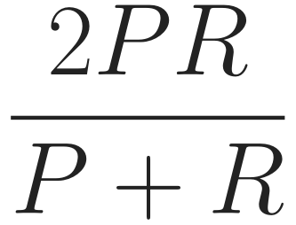
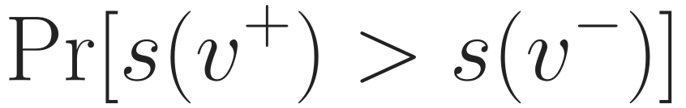
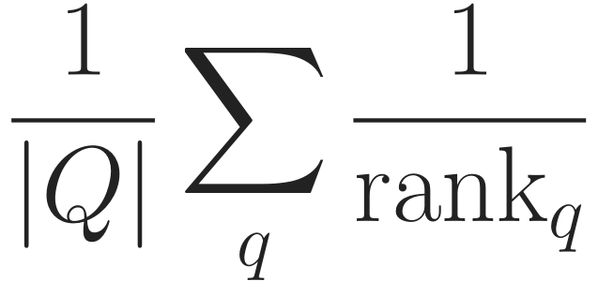
Evaluation metrics and protocol
Background
Problem
Method
Experiments
Discussion
Data
Metrics
Protocol
Cost
Ablation
Analysis
Macro-F1
Micro-F1
ROC-AUC
MRR
every class counts
overall correctness
true link above a hard negative
true link ranked first
node, graph: Macro/Micro-F1 · link: ROC-AUC, MRR (HGB 2-hop negatives)
Same data
files, splits, negatives
Tune seed 0
100 Bayesian trials
Retrain
seeds 0–4
Report
mean ± std
Test
Welch [24], raw + adj. p
Every baseline rerun under this rule, HetSheaf included (concern 4).
One rule for every method; model selection on the validation metric only.
Notes:
Metrics and protocol on one slide. Node and graph tasks report Macro-F1, where every class counts equally, and Micro-F1, which equals accuracy for single-label data. Link prediction follows HGB: ROC-AUC and MRR against negatives drawn from the head's two-hop neighbourhood. The protocol is one rule for every method: the same files and splits; Bayesian search with one hundred trials on seed zero using only the validation metric; retrain the best configuration on seeds zero to four; report mean and standard deviation; and test with Welch's t-test, raw and adjusted p-values. Every baseline, HetSheaf included, is rerun this way, which answers concern 4.

Slide 28
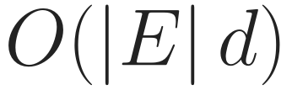
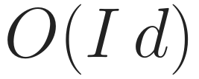
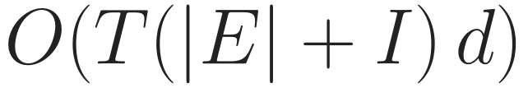
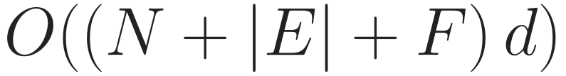
Cost: how it grows, and what we measured
Background
Problem
Method
Experiments
Discussion
Data
Metrics
Protocol
Cost
Ablation
Analysis
Growth (time unless noted)
Peak GPU memory on ACM (MB)
Maps
no d×d matrices
Faces
I = face incidences
Solve
T ≈ 10
Memory
not ∝ T
v1: O((|E|+I) d³) maps; HAN/SeHGNN: one graph per schema, can be denser than E
others: v1 Table 11; now: laptop, d = 32; time on server
Linear in edges and face incidences; ACM memory 9.3 GB → 2.8 GB (concern 3).
Notes:
Cost. Left, how it grows: maps are linear in edges times d, never d-by-d matrices; faces are linear in face incidences; the solve needs about ten passes over edges and incidences; and memory holds the states only, it does not grow with the number of solver steps. v1 built d-by-d maps at cubic cost in d, and meta-path methods such as HAN and SeHGNN build one graph per schema, which can be much denser than the original. Right, measured peak memory on ACM: v1 needed 9.3 GB; the current model 2.8 GB, below HAN and HINormer. The other bars come from the v1 paper's table on a different machine, and ours from a laptop GPU, so read it as an order of magnitude. A fair time comparison will be done on the server; the solver needs 9 to 11 steps on all three HGB datasets.

Slide 29
Ablation study: which part carries the gain?
Background
Problem
Method
Experiments
Discussion
Data
Metrics
Protocol
Cost
Ablation
Analysis
Remove or replace | If the full model wins, it shows | Answers
All faces (β = 0) | path instances add information | RQ2
Face → closing edge | a face is more than its endpoints | RQ2, concern 2
Face → feature of the head | structure beats instance features | RQ2
Weight → uniform / endpoints | who is on the path matters | RQ2
Edge maps → identity | maps are what handle heterophily | RQ1 (proposed)
Face maps → free maps | composing edge maps matters | design
One change per row, same paths and budget; the wording if it fails is fixed in advance.
Free maps as in copresheaf networks [15]; ablations, not rankings: a tuned R-GCN rivals many HGNNs [19]
Notes:
Which part carries the gain? Each row changes exactly one thing, with the same sampled paths, parameter budget and tuning. Removing all faces tests whether path instances add anything. Replacing a face by a closing edge tests whether it is more than its endpoints, reviewer concern 2. Feeding the path only to the head, as MAGNN does, tests structure against features. A uniform or endpoint-only weight tests whether who is on the path matters. These four answer RQ2. Identity edge maps test whether the maps are what handle heterophily, RQ1. Free face maps test the composition. What we write if the full model does not win is fixed before running.

Slide 30
Model analysis: when and why it works
Background
Problem
Method
Experiments
Discussion
Data
Metrics
Protocol
Cost
Ablation
Analysis
Gain vs. heterophily
Known-answer tasks
Schema read-out
gain plotted against ℋ²
label set by the intermediate node
weight per schema; stable?
RQ1
mechanism
interpretability
Path length
Scaling
Who gets weight
ℓmax = 2 … 6
memory, time vs. size, #faces
by intermediate type, label match
sensitivity
concern 3
RQ2
Ablations say which part helps; analyses say when, why, and at what cost.
Notes:
Six analyses explain when and why. Gain against H-squared tests whether the benefit grows with heterophily, RQ1. Known-answer synthetic tasks, where the label is decided by the intermediate node, test the mechanism directly. The schema read-out shows which schemas get weight and whether that is stable across seeds. Path length tests sensitivity to l-max. Scaling measures memory and time against graph size and number of faces, concern 3. And a case study of which instances get high weight, by intermediate type and whether the endpoints share a label, gives the qualitative side of RQ2.

Slide 31
What is new, and what is not
Background
Problem
Method
Experiments
Discussion
New
Not new (we say so)
Paths as faces of the graph’s own sheaf
Face reaches every node, no shortcut
Heterophily and meta-paths in one objective
Ablations as configurations of one model
Intermediate nodes: MAGNN, SGAT [12, 17]
Sheaves on typed graphs: HetSheaf [9]
The solver: personalised PageRank [16]
A special case equals MAGNN’s encoder
The contribution is where the path acts: inside one sheaf on the original graph.
Notes:
To be precise about novelty. New: paths are faces of the graph's own sheaf; a face reaches every node of its path without a shortcut; heterophily and meta-path information sit in one objective; and every ablation is a configuration of the same model. Not new: using intermediate nodes, which MAGNN and SGAT do; sheaves on typed graphs, which HetSheaf introduced; and the solver, which is personalised PageRank. With relation-only maps and the path used only as a feature, our face reduces to MAGNN's instance encoder; we state that openly.

Slide 32
Then and now: what changed since the submission
Background
Problem
Method
Experiments
Discussion
Aspect | v1 (submitted) | Now
Story | 3 contributions | heterophily on original graph; paths as structure
Face → nodes | only via closing edge | direct, every node
Propagation | K Hodge steps | one objective, one solve
Path selection | AMPSS + 4 budgets | WISP, no schema list
Node datasets | 3 (one heterophilic) | 8 across heterophily
Baselines | HetSheaf quoted | all rerun, same budget
Memory (ACM) | 9.3 GB | 2.8 GB
The core idea stayed; its weakest link (the closing edge) and the weak evidence were replaced.
Notes:
Side by side with the submitted version. The story moved from three contributions to two goals. The face used to reach nodes only through a closing edge; now it reaches every node directly. K Hodge steps became one objective and one solve. AMPSS with four budgets became WISP. Three node datasets, one of them heterophilic, became eight across the heterophily range. HetSheaf was quoted; now every baseline is rerun with the same budget. And ACM memory went from 9.3 to 2.8 GB.

Slide 33
Limitations and next steps
Background
Problem
Method
Experiments
Discussion
Limitations (stated in the paper)
Next steps (in order)
Influence is symmetric in strength; direction lives only in the maps
Propagation is linear; non-linearity is in the head
Edge states carry no input of their own (no edge features)
1
Mini-batch design for the large H2GB graphs
2
Baseline plan: coverage, search spaces, HetSheaf adapter
3
Server runs, then the analysis part
4
Analysis & Ablation Studies
Notes:
Limitations we will state. Influence is symmetric in strength: an edge or a face pulls all its members equally, and direction lives only in the maps; that is the price of having an energy with a unique solution. Propagation is linear and all non-linearity is in the head. Edge states carry no input of their own because the benchmarks have no edge features. Paths are simple, up to a maximum length, and sampled. Graph classification is typed by label. And five seeds on fixed splits measure seed variance only. Next steps, in order: the heterophily harness, starting by reproducing Hetero2Net's published values; the protocol code; the mini-batch design for the large graphs; the baseline plan including a HetSheaf adapter; and then the server runs and the analysis part.

Slide 34
Conclusion
Background
Problem
Method
Experiments
Discussion
Problem
Heterophily handled on per-schema graphs; paths reduced to endpoints
Idea
Original graph; maps for heterophily; each path instance a face
Method
One objective, one solve; WISP samples and weights paths
Next
RQ1, RQ2 on 8 + 8 + 4 datasets; ablations fixed in advance
Model implemented and tested; no accuracy numbers yet. Thank you.
Notes:
To conclude. The problem: heterophily is usually handled on per-schema graphs, and paths are reduced to their endpoints. Our idea: stay on the original graph, use learned maps for heterophily, and make each path instance a face. The method is one objective solved once, with WISP sampling and weighting the paths. Next, the two research questions are tested on node, link and graph tasks with ablations fixed in advance. The model is implemented and tested; there are no accuracy numbers yet. Thank you.

Slide 35
References
Background
Problem
Method
Experiments
Discussion
[1] Q. Lv et al. Are we really making much progress? Revisiting, benchmarking, and refining HGNNs. KDD 2021.
[2] T. N. Kipf and M. Welling. Semi-supervised classification with graph convolutional networks. ICLR 2017.
[3] J. Zhu et al. Beyond homophily in graph neural networks: Current limitations and effective designs. NeurIPS 2020.
[4] Y. Sun et al. PathSim: Meta path-based top-k similarity search in heterogeneous information networks. VLDB 2011.
[5] J. Lin et al. When heterophily meets heterogeneity: Challenges and a new large-scale graph benchmark. KDD 2025.
[6] O. Platonov et al. Characterizing graph datasets for node classification: Homophily-heterophily dichotomy and beyond. NeurIPS 2023.
[7] J. Hansen and T. Gebhart. Sheaf neural networks. arXiv:2012.06333, 2020.
[8] C. Bodnar et al. Neural sheaf diffusion: A topological perspective on heterophily and oversmoothing in GNNs. NeurIPS 2022.
[9] L. Braithwaite et al. Heterogeneous sheaf neural networks. arXiv:2409.08036, 2024.
[10] X. Wang et al. Heterogeneous graph attention network. WWW 2019.
[11] X. Yang et al. Simple and efficient heterogeneous graph neural network. AAAI 2023.
[12] X. Fu et al. MAGNN: Metapath aggregated graph neural network for heterogeneous graph embedding. WWW 2020.
Notes:
References for the citations on the slides.

Slide 36
References (cont.)
Background
Problem
Method
Experiments
Discussion
[13] I. Duta et al. Sheaf hypergraph networks. NeurIPS 2023.
[14] C. Bodnar et al. Weisfeiler and Lehman go cellular: CW networks. NeurIPS 2021.
[15] M. Hajij et al. Copresheaf topological neural networks: A generalized deep learning framework. NeurIPS 2025.
[16] J. Gasteiger et al. Predict then propagate: Graph neural networks meet personalized PageRank. ICLR 2019.
[17] S. H. Lee et al. SGAT: Simplicial graph attention network. IJCAI 2022.
[18] J. Li et al. Heterophily-aware representation learning on heterogeneous graphs (Hetero²Net). IEEE TPAMI 2025.
[19] X. Yang et al. Are heterogeneous graph neural networks truly effective for node classification? A causal perspective. arXiv:2510.05750, 2025.
[20] J. Guo et al. Homophily-oriented heterogeneous graph rewiring. WWW 2023.
[21] Z. Shen and Z. Kang. When heterophily meets heterogeneous graphs: Latent graphs guided unsupervised representation learning. IEEE TNNLS 2025.
[22] X. Fu and I. King. MECCH: Metapath context convolution-based heterogeneous graph neural networks. Neural Networks 2024.
[23] C. Morris et al. TUDataset: A collection of benchmark datasets for learning with graphs. ICML GRL+ Workshop 2020.
[24] B. L. Welch. The generalization of “Student’s” problem when several different population variances are involved. Biometrika 1947.
Notes:
References for the citations on the slides.

Slide 37
References (cont.)
Background
Problem
Method
Experiments
Discussion
[25] S. Yun et al. Graph transformer networks. NeurIPS 2019.
[26] C. Li et al. Long-range meta-path search on large-scale heterogeneous graphs (LMSPS). NeurIPS 2024.
[27] Q. Chen and G. Song. Adaptive heterogeneous graph neural networks: Bridging heterophily and heterogeneity. CIKM 2025.
[28] J. Kim et al. Leveraging multi-facet paths for heterogeneous graph representation learning (MF2Vec). arXiv:2407.20648, 2024.
[29] C. Li, H. Xu and K. He. Differentiable meta multigraph search with partial message propagation (PMMM). AAAI 2023.
[30] X. Li et al. Adaptive meta-path-based neural architecture search for heterogeneous graphs (AMP-HGNAS). Information Sciences 2026.
[31] B. Zhang et al. A new meta-path Monte Carlo tree search algorithm for HGNNs. Machine Intelligence Research 2026.
Notes:
References for the citations on the slides.

Slide 38
Appendix: where WISP can lose, and how we test it
Background
Problem
Method
Experiments
Discussion
Where it can be weaker
How we test it
Rare long schemas get few samples; LMSPS gains at 5–6 hops [26]
Budget not focused: adaptive sampling cut variance only 4.9% (gate 20%)
Weight capacity shown with an oracle (0.99), but g has not yet learned selection on a synthetic task
Schema-free walks already exist (MF2Vec [28])
Weight ladder: uniform / schema / endpoints / full
Fixed expert list on the same model
LMSPS-searched schemas, same budget (proposed)
Path length ℓmax = 2 … 6
If search wins, the claim narrows to: no schema list, linear cost, per-instance weights.
Notes:
Backup for the WISP question. Where it can be weaker: rare long schemas are sampled rarely, while LMSPS reports gains at five to six hops; the sampling budget is not focused, our adaptive proposal reduced variance by only 4.9 percent, below the 20 percent gate; the weight channel has the capacity to select, shown with an oracle at 0.99, but the learned weight did not yet pick the right instances on a synthetic task; and schema-free walks themselves are not new. Tests: the weight ladder, the expert list on the same model, a proposed run that feeds LMSPS's searched schemas into our model at the same budget, and the path-length curve. If search wins, the claim narrows to no schema list, linear cost and per-instance weights.

Slide 39
Appendix: hyperparameters per step (tuned, fixed, learned)
Background
Problem
Method
Experiments
Discussion
Step | Tuned | Fixed (never tuned) | Learned
Encode | d, dropout | – | type encoders
Edge maps | – | 2 reflections | map MLP, aₑ
WISP | – | ℓmax = 4, walks r | weight MLP g
Objective / Solve | – | tolerance, max steps | τ
Head | dropout | width 128 | MLP
Training | lr, weight decay | AdamW, clip 1.0 | –
9 + 4
v1
tuned + budgets
5 + 2
Now
tuned + fixed
No depth to tune: v1 also tuned K steps and two step sizes
Notes:
Every knob, step by step. Red: the five things we tune, d, two dropouts, learning rate and weight decay, plus pooling for graph classification. Fixed and never tuned: two reflections per map, maximum walk length 4 and the number of walks, set by a rule; solver tolerance and step limit. Learned: encoders, maps, weights, and tau, the strength of agreement. v1 tuned nine and needed four hand-set budgets; now five tuned plus two fixed path settings, and no depth.

Slide 40
Appendix: the full energy (edge states and normalisation)
Background
Problem
Method
Experiments
Discussion
sₑ: state of edge e, the meeting point of its two ends and every face through it
Edges on no face: sₑ eliminated exactly, giving ¼ aₑ‖Fᵤxᵤ − Fᵥxᵥ‖² (the main-text form)
Rₑ,f = Tᵥ,f Fᵥ◁ₑᵀ: edge→face map, also composed; no closing edge
Normalised: L̂ = D⁻¹ᐟ² L D⁻¹ᐟ², so cond(I + τŜ) ≤ 1 + τ for any graph size
Notes:
Backup for questions: the full energy as implemented. Each edge has its own state s_e, the meeting point of its two ends and every face through it; for edges on no face it is eliminated exactly and gives the simpler form used in the main slides. Edge-to-face maps are also composed. The operator is normalised by its diagonal, which bounds the condition number independently of graph size.

Slide 41
Appendix: why v1’s face never reached the nodes
Background
Problem
Method
Experiments
Discussion
Coupling | v1: Hodge diffusion + closing edge | H2S-NN
face → P1, A7, P9 | 0 for any number of steps | direct
P1 ↔ P9 shortcut | yes (closing edge) | none
In Hodge diffusion with δ₁δ₀ = 0, the face→node block is exactly zero (proved; checked to 1e-16)
v1’s only route was the closing edge between the ends: the endpoint view (concern 2)
Notes:
Backup: the formal reason behind reviewer concern 2.

Slide 42
Appendix: terms used in this talk
Background
Problem
Method
Experiments
Discussion
Term | Meaning
Heterogeneous graph | nodes and edges have types
Heterophily | linked nodes tend to have different labels (or features)
Meta-path schema | a type pattern, e.g. paper–author–paper (PAP)
Path instance | one concrete walk that follows it, e.g. P1–A7–P9
Restriction map F | learned map from a node into the space of an edge
Face | a cell placed above one sampled path instance (no closing edge)
Energy | sum of disagreements between touching cells, after the maps
WISP | Walk-sampled, Instance-weighted Sheaf Paths: the sampler + weights
τ | learned strength of agreement in the solve
Notes:
Glossary for questions.

